Slide 1
Resume Analyzer
Group Member-1: Shivam Sinha (2K22/SE/166)
Group Member-2: Shubham Jha (2K22/SE/168)
Machine Learning
SE-204
Batch: SE/A2

Slide 2
Outline of the project
Motivation
Introduction
Dataset
Research Methodology
Results
Limitation
Conclusion

Slide 3

Motivation
Why Resume Analyzer?
Career Opportunities: In today’s competitive job market, a well-crafted resume is crucial for landing interviews. However, manually reviewing hundreds of resumes is time-consuming for recruiters.
Machine Learning Solution: By automating resume analysis using machine learning, we can help recruiters quickly identify relevant candidates.

Slide 4
Motivation
What Motivated Us?
Industry Trends: The rise of AI and automation has transformed recruitment
Personal Experience: As second-year software engineering students, we’ve personally faced the daunting task of tailoring our resumes for internships and jobs.
Impact: Our project has the potential to impact both job seekers and recruiters.
NLP Advancements: Recent advancements in natural language processing (NLP) allow us to extract valuable information from resumes, including skills, experience, and education.

Slide 5
Introduction
Problem Statement: Traditional resume screening is time-consuming and error-prone. Recruiters struggle to sift through a large volume of resumes to find the right candidates.
Our Project: Resume Analyzer: Our project, Resume Analyzer, uses machine learning and natural language processing (NLP) to automatically analyze resumes.
Key Features:
Skill Extraction: Identifies relevant skills, certifications, and qualifications.
Experience Assessment: Evaluates work experience and tenure.
Education Highlight: Recognizes educational background and degrees.

Slide 6
Introduction
Real-World Challenges
Volume Overload: Recruiters receive hundreds of resumes for a single job posting. Manually reviewing each one is impractical.
Hidden Gems: Talented candidates often get overlooked due to time constraints or biased screening.
Matching Complexity: Finding the right fit involves aligning job requirements with candidate profiles.
How We Solve Them
Efficiency: Resume Analyzer automates the initial screening process, saving recruiters valuable time.
Fairness: Our system ensures equal opportunities for all applicants.
Precision: Our model identifies relevant candidates more accurately, improving the quality of shortlisted resumes.

Slide 7
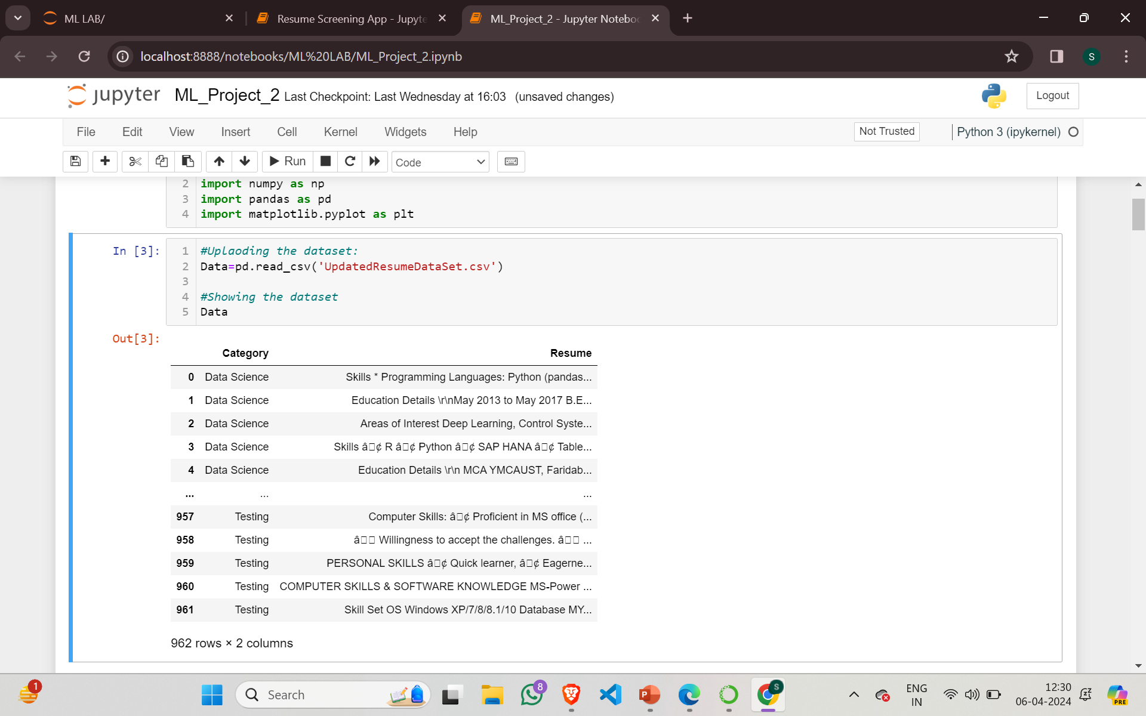
Dataset
Name of the Dataset: Resume Dataset
Source: Resume Dataset From Kaggle
Size of the Dataset: (962,2): We have 962 Examples with 2 columns

Slide 8
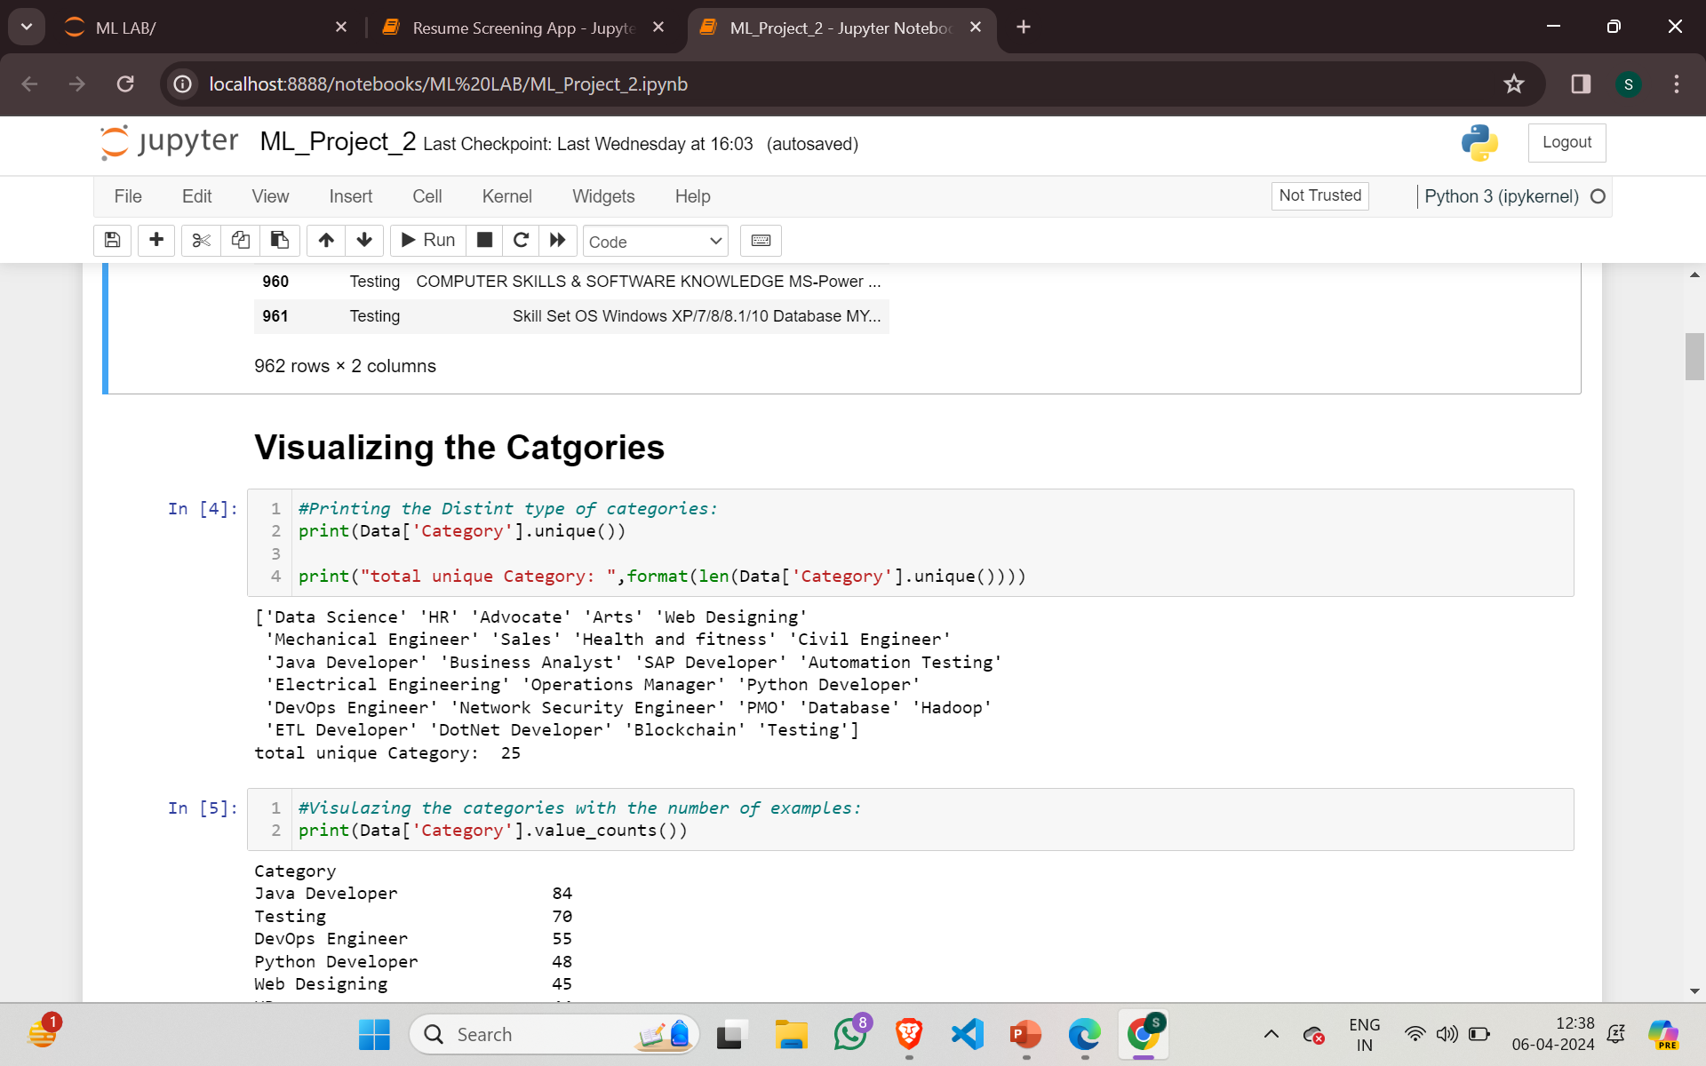
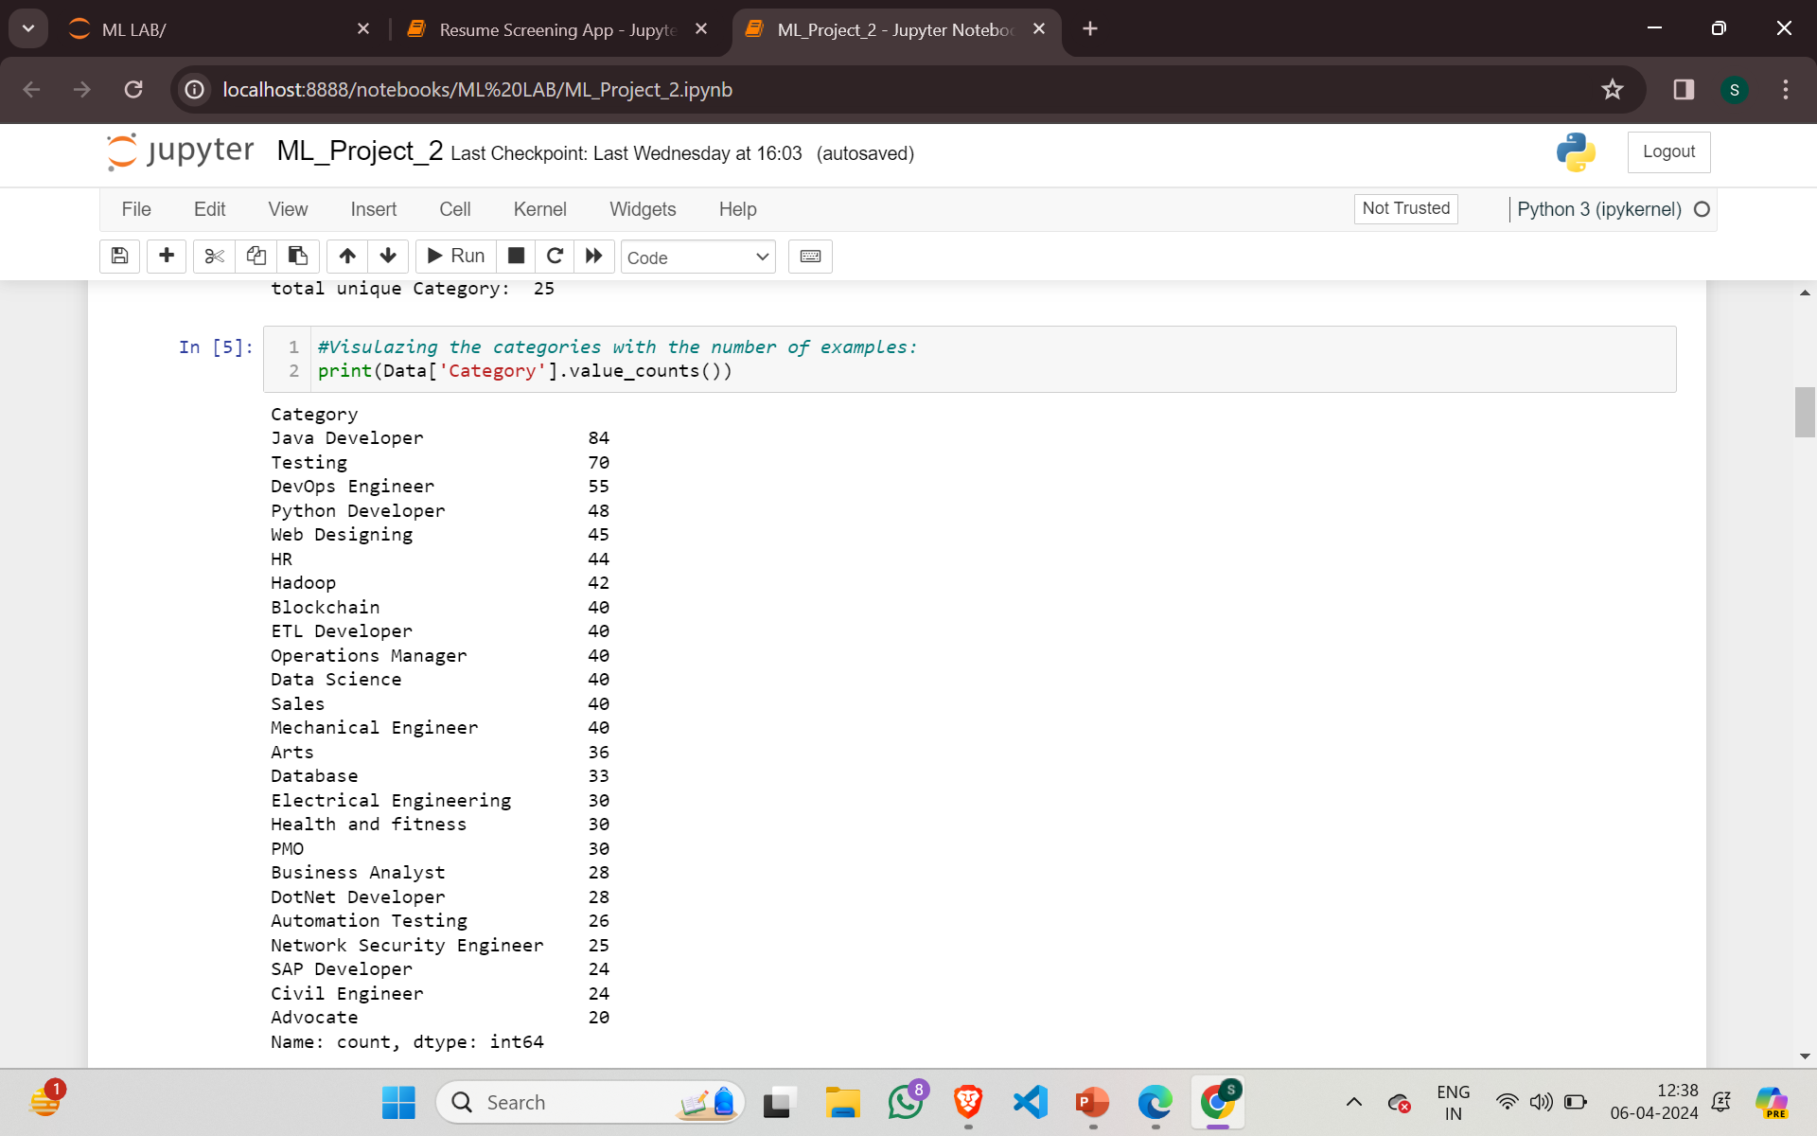
Dataset
Visualizing the Categories in the Dataset:

Slide 9
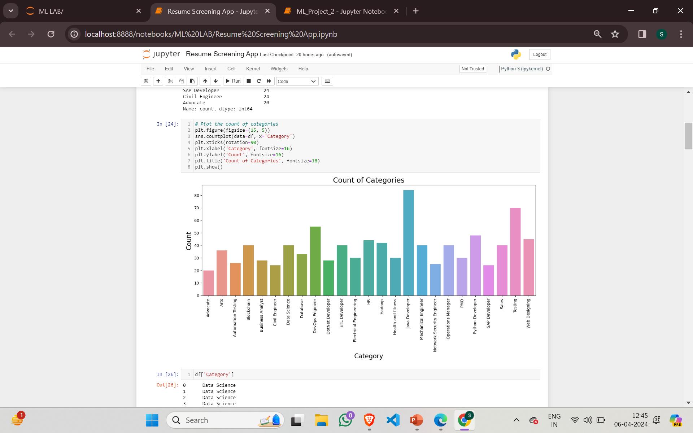
Dataset
Category Distribution in the Dataset through a bar graph:

Slide 10
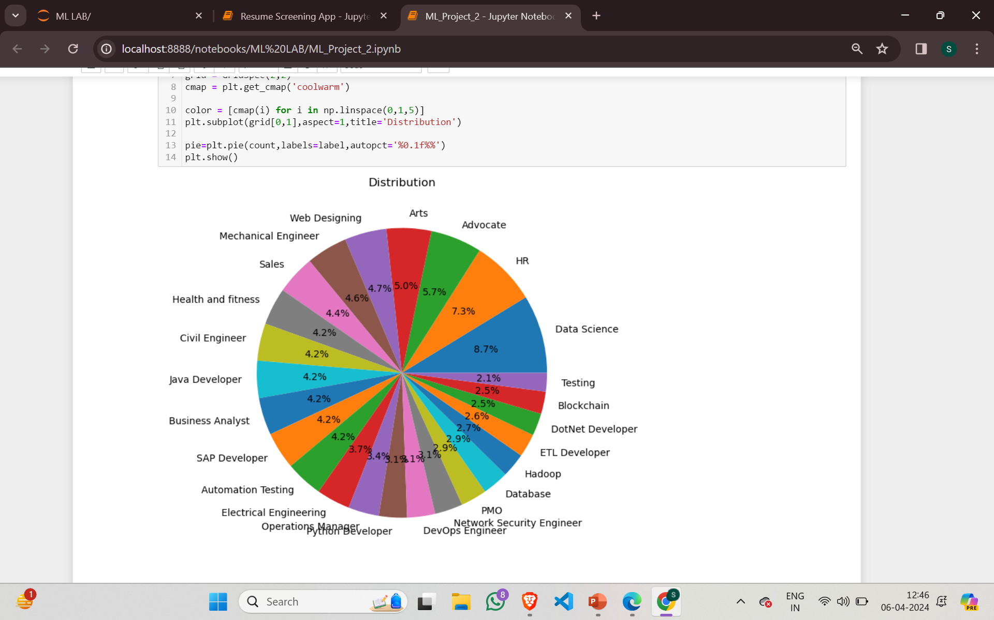
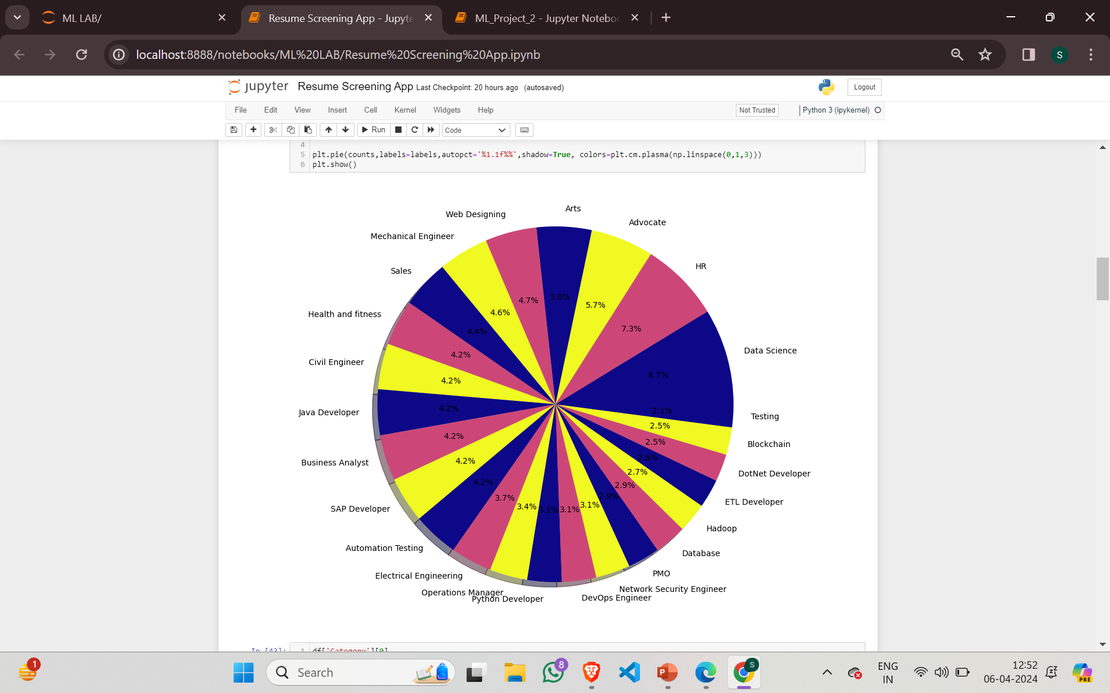
Dataset
Category Distribution in the Dataset through a pie chart

Slide 11
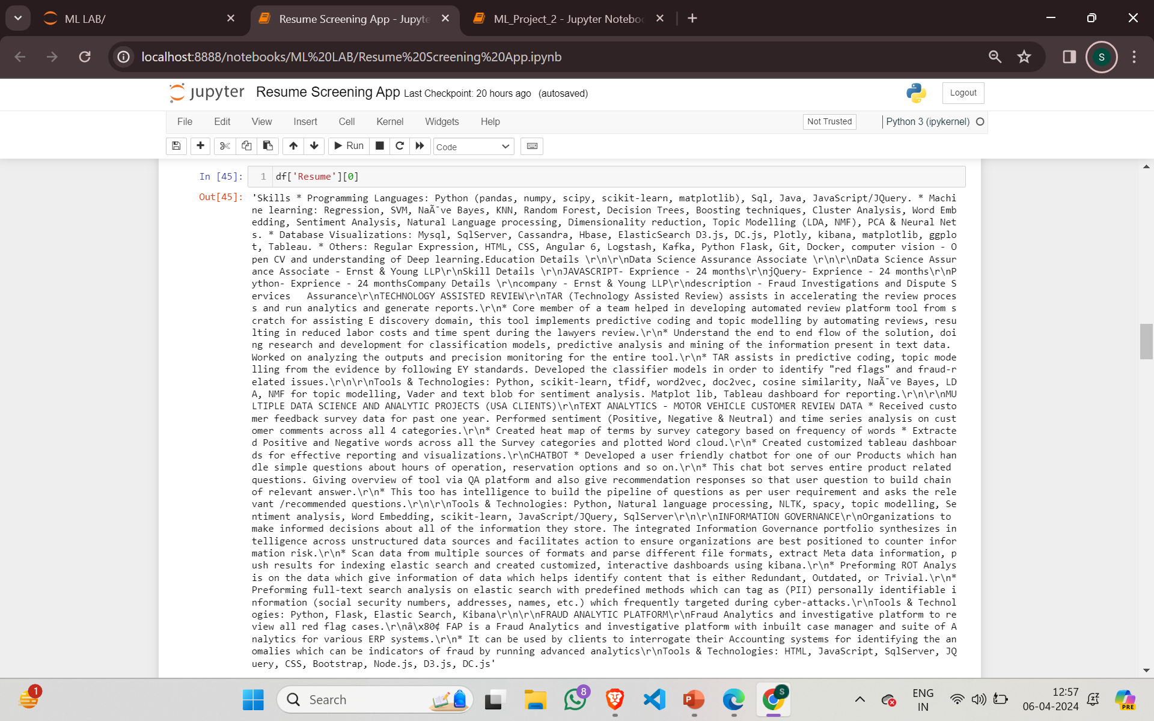
Dataset
A Sample Resume From the Dataset:

Slide 12
Dataset
Charactertics of the Dataset:
1. Data Format:
Resumes are available in both PDF and String formats.
String format allows for easy data extraction.
2. Feature Set Significance:
Datatype: Text (for skills, experience, education, etc.)
Data Scale: Nominal (categorical) and Ordinal (e.g., years of experience)

Slide 13
Research Methodology
1. Data Collection
2. Data Preprocessing Techniques
3. Feature Extraction
4. Model Development
5.Performance Measures
Obtained the Dataset From Kaggle
Uploaded the Dataset as a Data-frame in the model
Text Cleaning
Data Transformation
Visualizing the Categories in the Dataset.
TF-IDF Vectorization
Splitting the Dataset
Naïve bayes
KNN
SVM
Logistic Regression
Random Forest
Cross Validation Methods
Confusion Matrix
Testing/Training Score
Accuracy
Precision
F1-Score
Specificity

Slide 14
Research Methodology
Data Collection : From Kaggle : Resume Dataset
Data Preprocessing Techniques:
What is Data Preprocessing?
Definition: Data preprocessing refers to the cleaning, transforming, and organizing of raw data before it is used for analysis or model training.
Explanation:
Cleaning: Removing inconsistencies, missing values, and noise from the dataset.
Transforming: Standardizing or normalizing features to a common scale.
Organizing: Structuring data for efficient processing.

Slide 15
Research Methodology: Data Preprocessing
Significance of Data Preprocessing
Noise Reduction:
Problem: Raw data often contains noise, outliers, or irrelevant information.
Solution: Data preprocessing helps remove noise, ensuring cleaner and more reliable data for model training.
Handling Missing Values:
Problem: Real-world datasets often have missing values due to various reasons.
Solution: Techniques like imputation (replacing missing values with estimates) ensure data completeness.
Feature Scaling:
Problem: Features may have different scales (e.g., salary vs. age), affecting model performance.
Solution: Standardizing or normalizing features ensures fair comparisons and stable model behaviour.
Text Data Processing:
Problem: Text data (such as resumes) is unstructured and requires special handling.
Solution: Techniques like tokenization, stop word removal, and lemmatization prepare text for analysis.

Slide 16
Research Methodology: Data Preprocessing
Preprocessing Techniques Used: Text Cleaning
What is Text Cleaning?
Text cleaning, also known as text preprocessing, is a crucial step in preparing unstructured text data for analysis or machine learning tasks. It involves transforming raw text into a cleaner, more structured format.
Why Text Cleaning for our Dataset?
Resumes often contain irrelevant information, such as formatting artifacts, special characters, or URLs.
Stop words (common words like “the,” “and,” “in”) don’t contribute much to the meaning.

Slide 17
Research Methodology: Data Preprocessing
What does Text Cleaning Includes?
1. Tokenization: Splitting text into individual words or tokens. Tokenization breaks down sentences or paragraphs into smaller units
2. Stop Word Removal: Filtering out common words that don’t carry significant meaning. Stop words (e.g., “the,” “and,” “in”) are frequently occurring words that add little value to text analysis.
3. Handling Non-ASCII Characters: Non-ASCII characters (e.g., emojis, foreign characters) can cause issues during analysis. Removing them ensures compatibility.
4. Dealing with URLs, Mentions, and Hashtags: These elements are often irrelevant for text analysis and can be safely discarded.

Slide 18
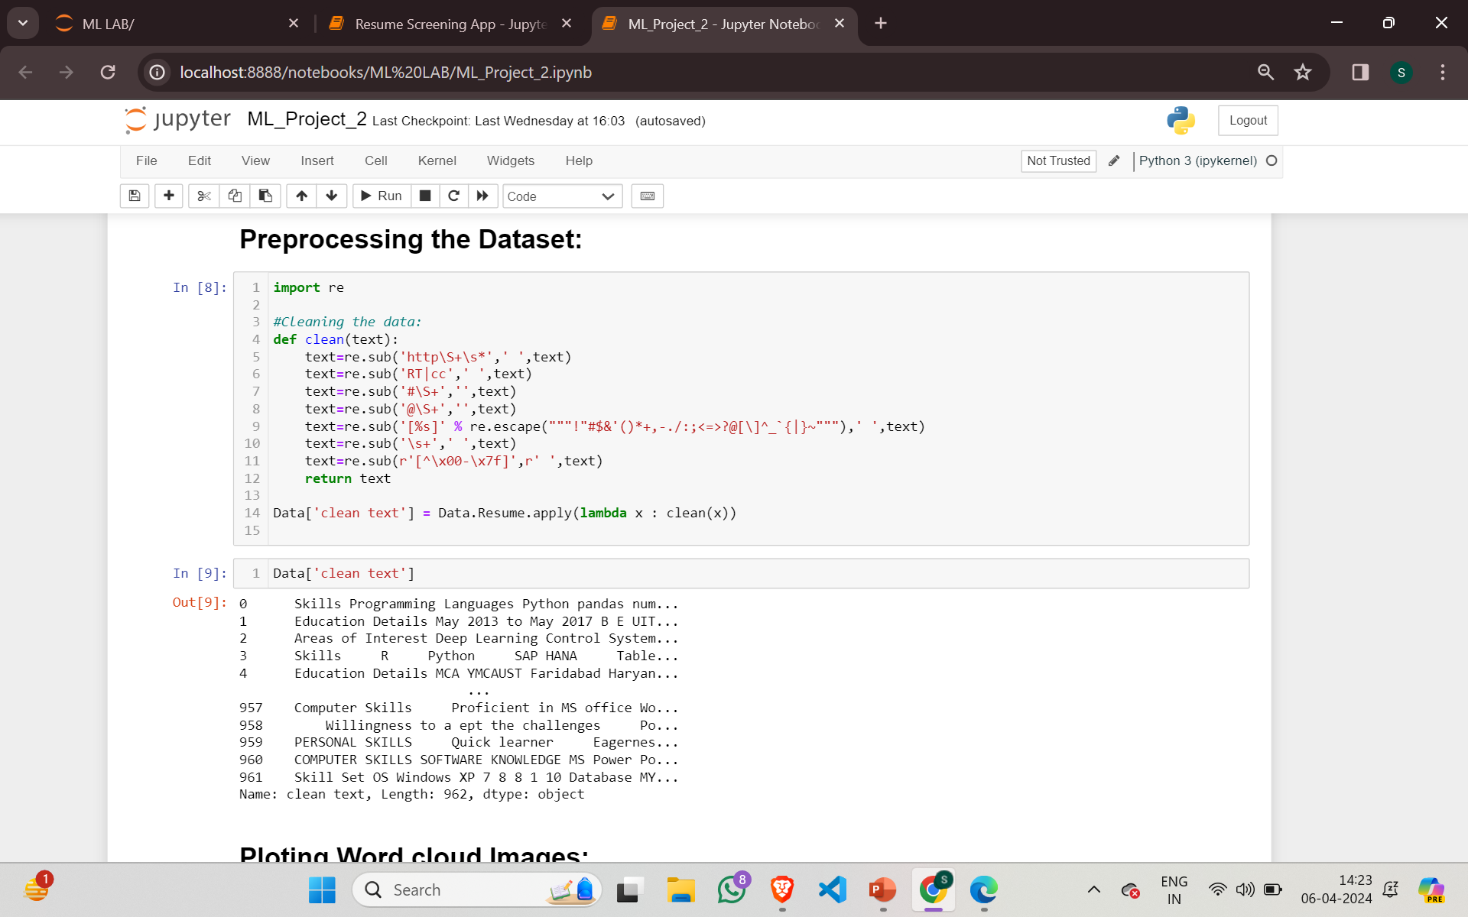
Research Methodology: Data Preprocessing
Cleaning the Text in the Dataset:
Code:

Slide 19
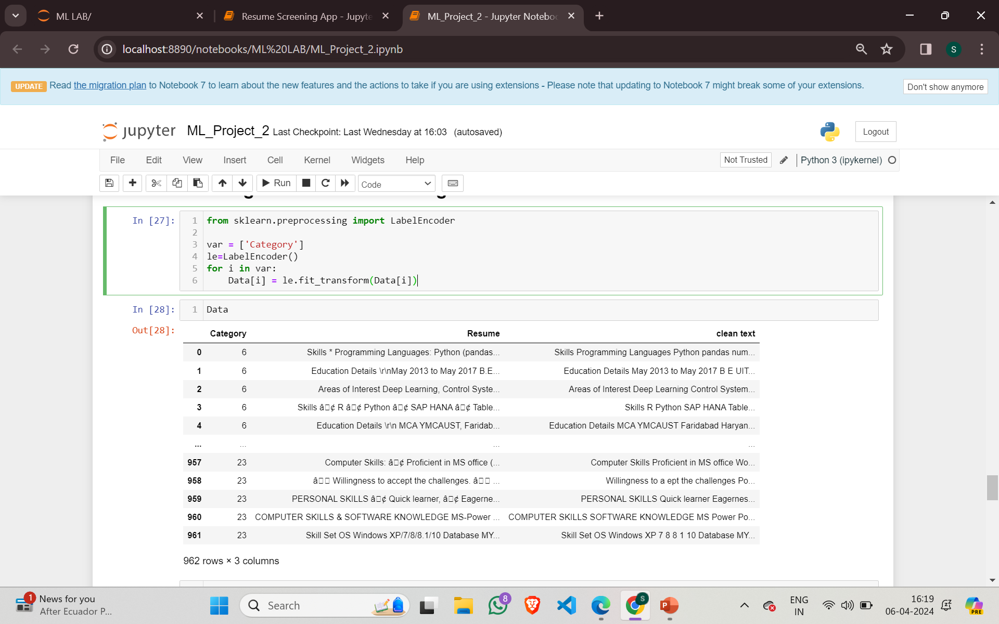
Research Methodology: Data Preprocessing
Data Transformation: Data transformation refers to the process of altering or converting data from its original format into a different representation. For e.g. : Converting categorical data (e.g., text labels) into numerical representations.
Code:

Slide 20
Research Methodology: Data Preprocessing
Comparison between Raw and Pre-processed Data:

Slide 21
Research Methodology: Feature Extraction
3. Feature Extraction:
What is Feature Extraction?
Feature extraction is the process of transforming raw data (such as text, images, or signals) into a reduced set of meaningful features. extract relevant information from the original data while reducing dimensionality.
Why Feature Extraction on a Resume Dataset?
High Dimensionality: Resume datasets often contain numerous features
Simplify Representation: Feature extraction condenses this information into a more manageable form.
Enhance Model Performance: Extracted features improve model accuracy and generalization.

Slide 22
Research Methodology: Feature Extraction
Significance of Feature Extraction
Improved Model Efficiency: Fewer features mean faster training and prediction.
Noise Reduction: Extracted features focus on relevant information, reducing noise.
Interpretability: Simplified features are easier to understand and explain.
Feature Extraction Technique Used: TF-IDF vectorization

Slide 23
Research Methodology: Feature Extraction
What is TF-IDF?
TF-IDF is a numerical representation of text data that captures the importance of each term within a collection of documents (corpus). It helps transform raw text into feature vectors suitable for machine learning models.
How It Helps in Feature Extraction:
Feature Representation: Each document is represented as a vector of TF-IDF scores for its terms.
Dimensionality Reduction: TF-IDF reduces the dimensionality of the text data.
Model Input: These vectors serve as input features for machine learning models.

Slide 24
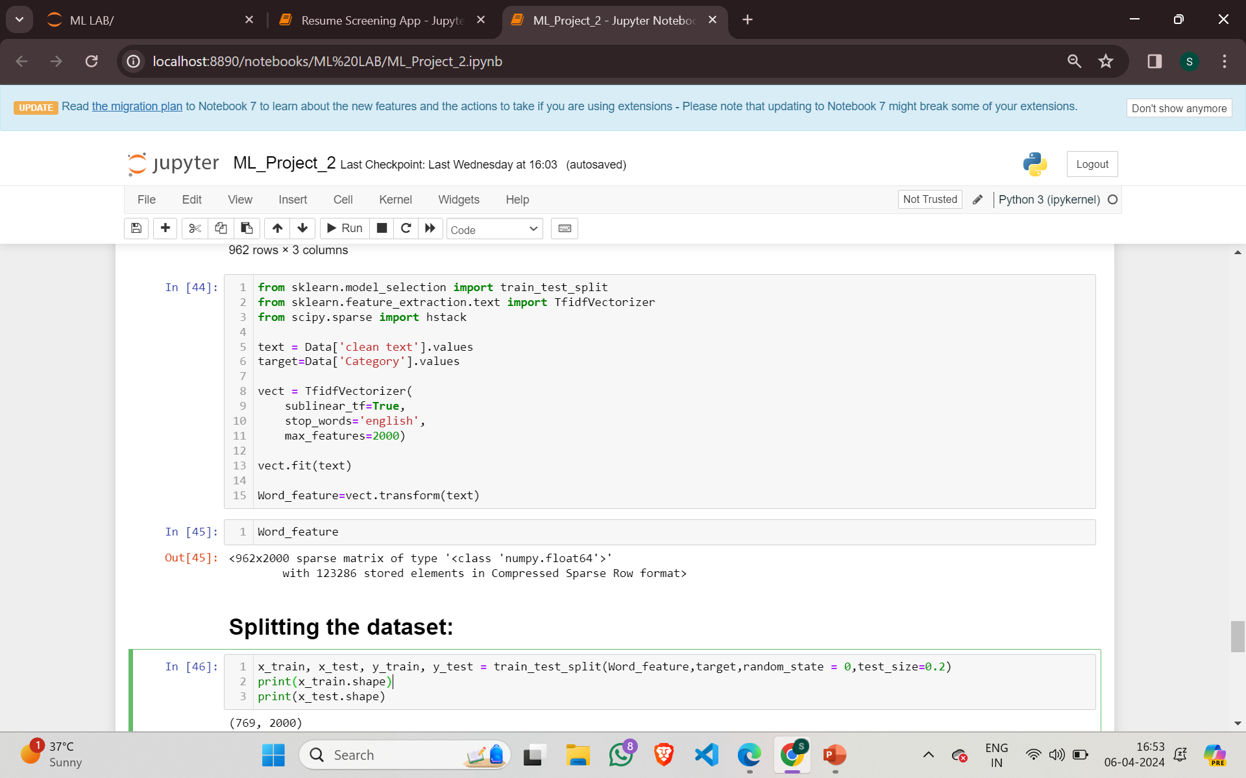
Research Methodology: Feature Extraction
Code:

Slide 25
Research Methodology: Model Development
What is Model Development?
Model development refers to the process of creating, training, evaluating, and fine-tuning machine learning models. It is a crucial step in building predictive systems for various tasks, such as classification, regression, clustering, and recommendation.
Resume Data Characteristics:
Text-based (resumes, job descriptions).
Multiclass classification (job categories).
Limited features (skills, experience, education).

Slide 26
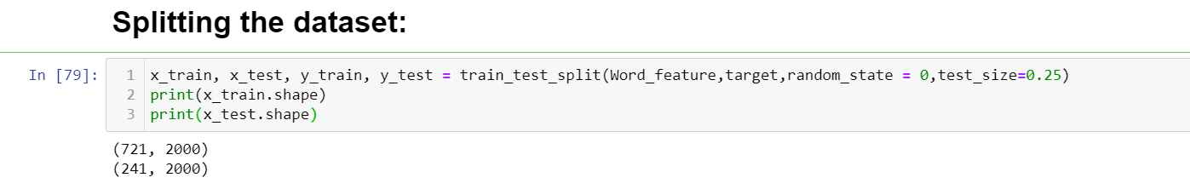
Research Methodology: Model Development
Splitting the Dataset:
We divided our Dataset into training data and testing data in the ratio of 75/25.
Total Examples: 962
Examples in Training set: 721
Examples in Testing set: 241

Slide 27
Research Methodology: Model Development
Machine Learning Algorithms implemented in our model:
Naïve Bayes
Support Vector Machine
Logistic Regression
K-Nearest Neighbour
Random Forest

Slide 28
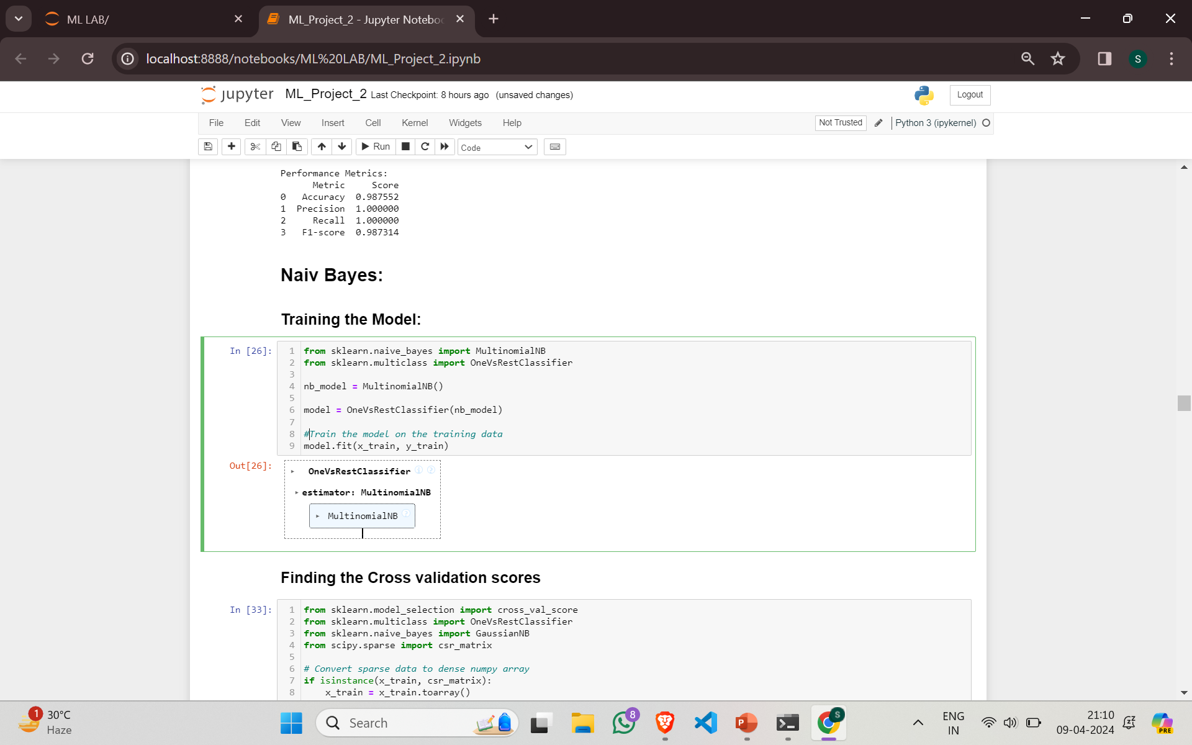
Research Methodology: Model Development
1. Naive Bayes:
Training the model with Naïve Bias:

Slide 29
Research Methodology: Model Development
1. Naive Bayes:
Why Naïve Bayes for our Model?
1. Independence Assumption:Naive Bayes assumes that each feature is independent of others, given the class label.
2. Text Classification:Resumes contain high-dimensional text features. Each word represents a feature.
3. Speed and Simplicity:It’s fast and makes predictions easily, even with high-dimensional data. For real-world applications requiring quick responses.

Slide 30
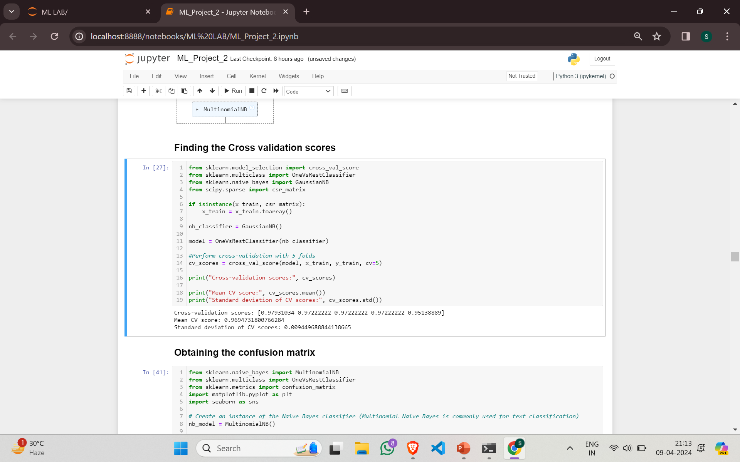
Research Methodology: Model Development
1. Naive Bayes:
How Naive-Bayes Performed on our Model?
Cross Validation Scores:
Cross Validation Method Applied: K-folds (K=5)
Cross Validation scores: {0.98,0.97,0.97,0.97,0.95}
Mean Cross Validation scores: 0.9694
Standard deviation of Cross Validation Scores: 0.00944

Slide 31
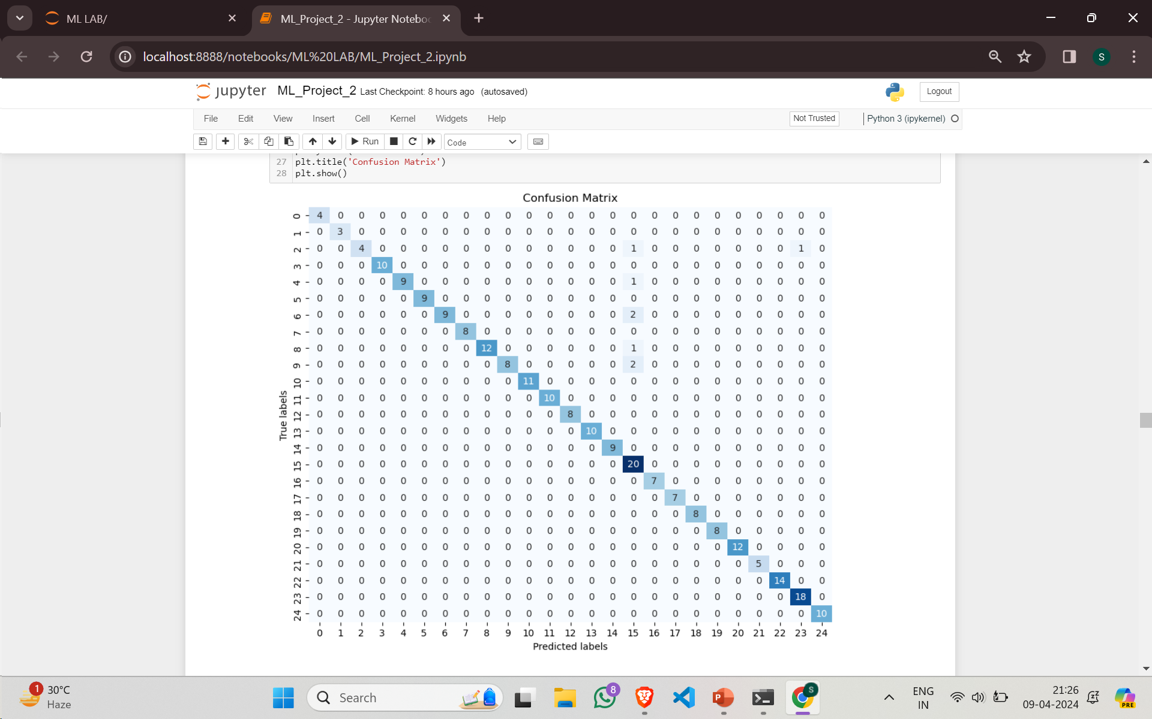
Research Methodology: Model Development
1. Naive Bayes:
How Naive-Bayes Performed on our Model?
Confusion Matrix:

Slide 32
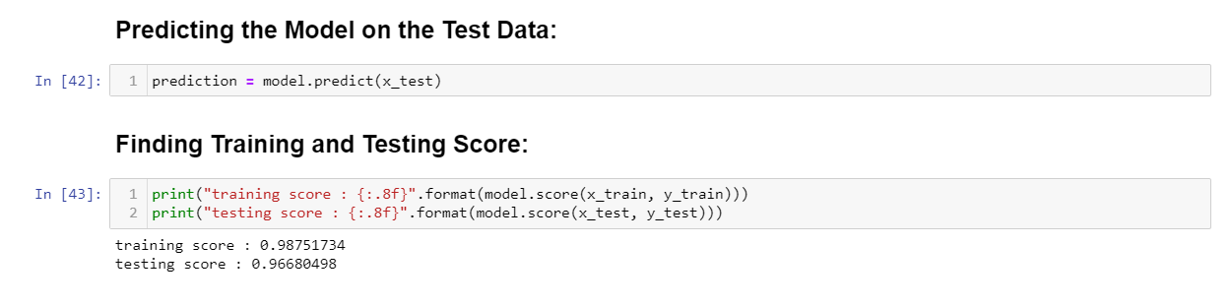
Research Methodology: Model Development
Naive Bayes:
How Naive-Bayes Performed on our Model?
Calculating the Training and Testing Scores:
Training score: 0.98
Testing score: 0.96
Code:

Slide 33
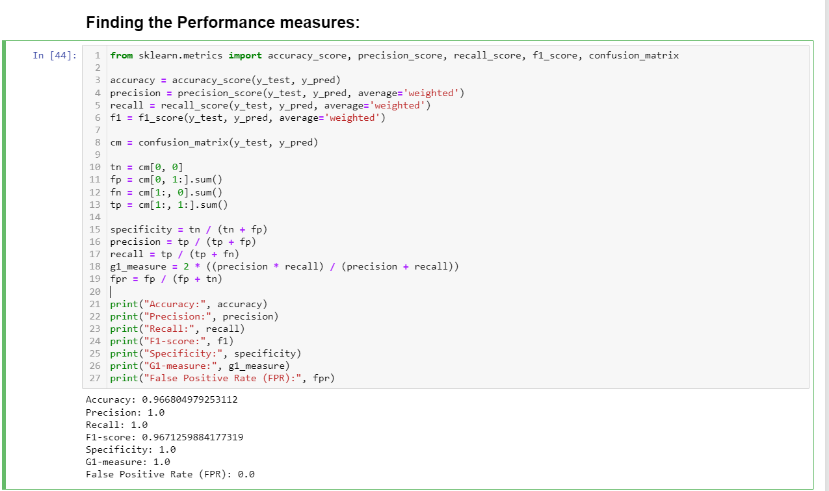
Research Methodology: Model Development
1. Naive Bayes:
How Naive-Bayes Performed on our Model?
Performance Measures:
Accuracy: 0.96
Precision: 1.0
Recall: 1.0
F1-Score: 0.96
Specificity: 1.0
G1-measure: 1.0
False Positive Rate: 0.0

Slide 34
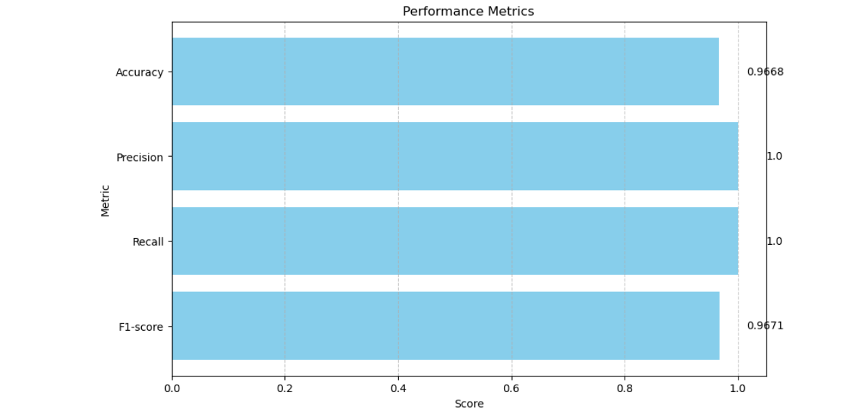
Research Methodology: Model Development
1. Naive Bayes:
How Naive-Bayes Performed on our Model?
Performances through graphs:

Slide 35
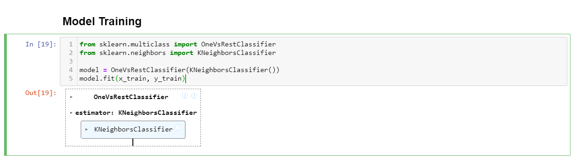
Research Methodology: Model Development
2. K-Nearest Neighbour:
Training the model with KNN:

Slide 36
Research Methodology: Model Development
2. K-Nearest Neighbour:
Why K-Nearest Neighbour for our Model?
1. Small Dataset Compatibility: KNN performs well with small datasets.
2. Parameter Tuning : KNN can be easily tuned to improve accuracy. Choosing the right value of k (number of neighbors) is essential for better results.
3. Versatility: KNN can be applied to both classification and regression problems

Slide 37
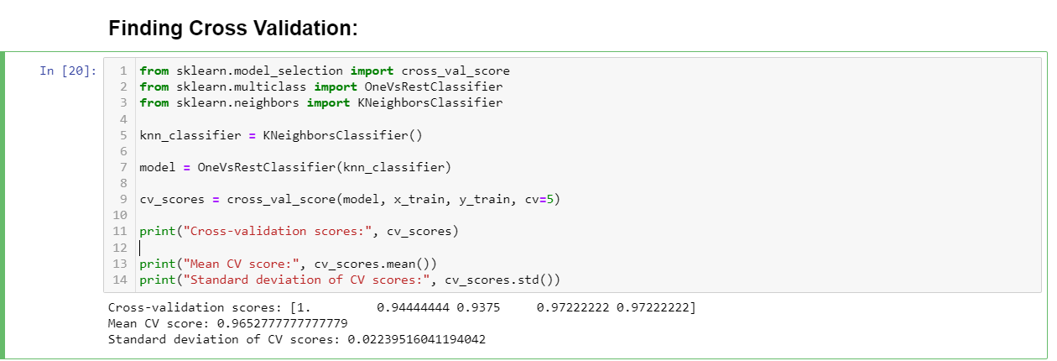
Research Methodology: Model Development
2. K-Nearest Neighbour:
How K-Nearest Neighbor Performed on our Model?
Cross Validation Scores:
Cross Validation Method Applied: K-folds (K=5)
Cross Validation scores: {1.0,0.94,0.93,0.97,0.97}
Mean Cross Validation scores: 0.9627
Standard deviation of Cross Validation Scores: 0.0223

Slide 38
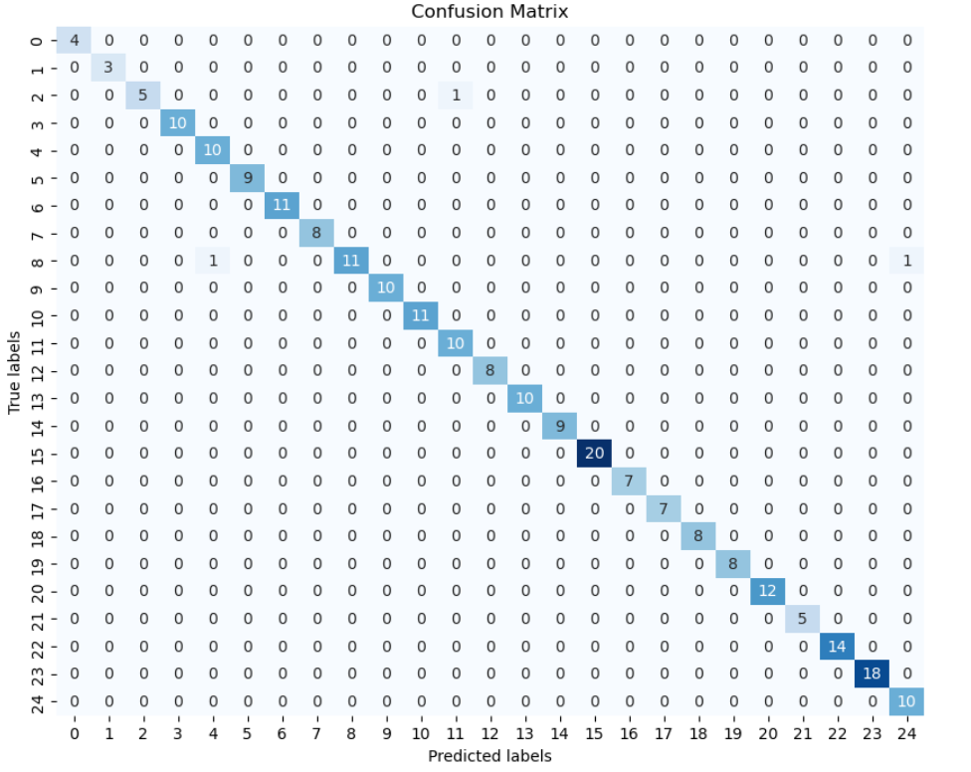
Research Methodology: Model Development
2. K-Nearest Neighbour:
How K-Nearest Neighbor Performed on our Model?
Confusion Matrix:

Slide 39
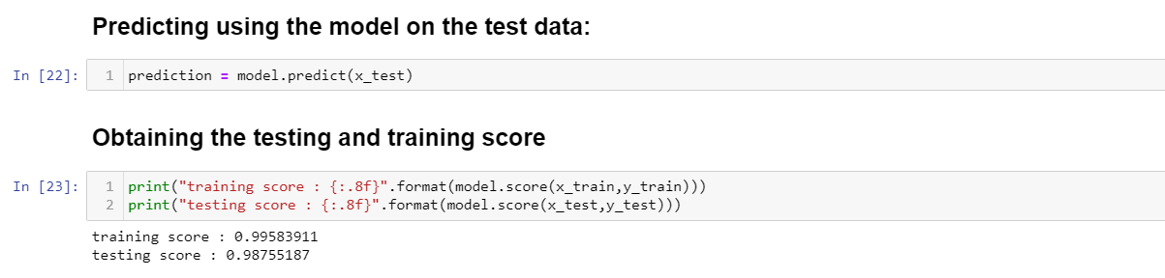
Research Methodology: Model Development
2. K-Nearest Neighbour:
How K-Nearest Neighbor Performed on our Model?
Calculating the Training and Testing Scores:
Training score: 0.99
Testing score: 0.98
Code:

Slide 40
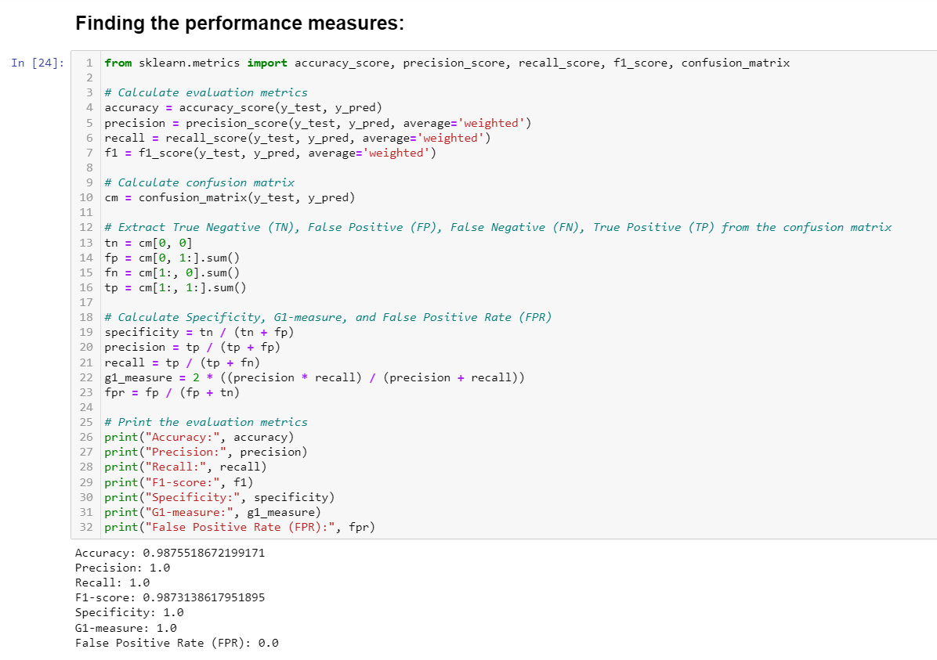
Research Methodology: Model Development
2. K-Nearest Neighbours:
How KNN Performed on our Model?
Performance Measures:
Accuracy: 0.98
Precision: 1.0
Recall: 1.0
F1-Score: 0.98
Specificity: 1.0
G1-measure: 1.0
False Positive Rate: 0.0

Slide 41
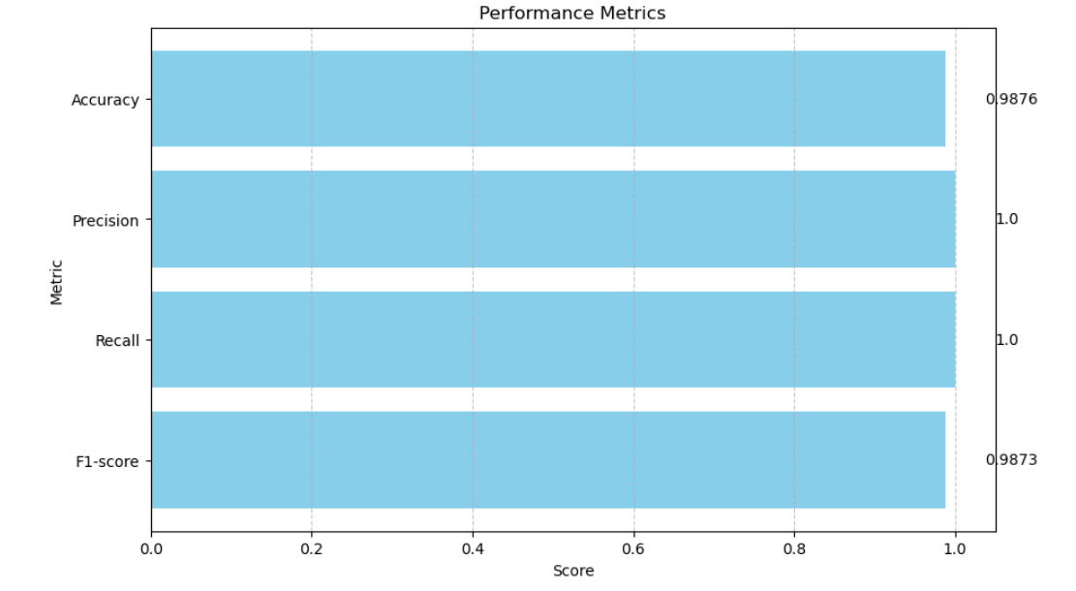
Research Methodology: Model Development
2. K-Nearest Neighbour:
How K-Nearest Neighbor Performed on our Model?
Performances through graphs:

Slide 42
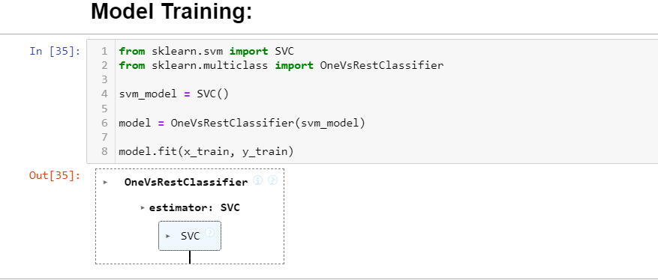
Research Methodology: Model Development
3. Support Vector Machine:
Training the model with SVM:

Slide 43
Research Methodology: Model Development
3. Support Vector Machine:
Why SVM for our Model?
1. Effective in High-Dimensional Spaces : SVM generalizes well in high-dimensional spaces, making it suitable for text-based data like resumes
2. Memory Efficiency : SVM uses a subset of training points (called support vectors) in the decision function This memory-efficient approach allows SVM to handle large datasets.
3. Non-Linear Classification: SVM can handle non-linear classification tasks. It finds optimal hyperplanes even when the decision boundary is not a straight line.

Slide 44
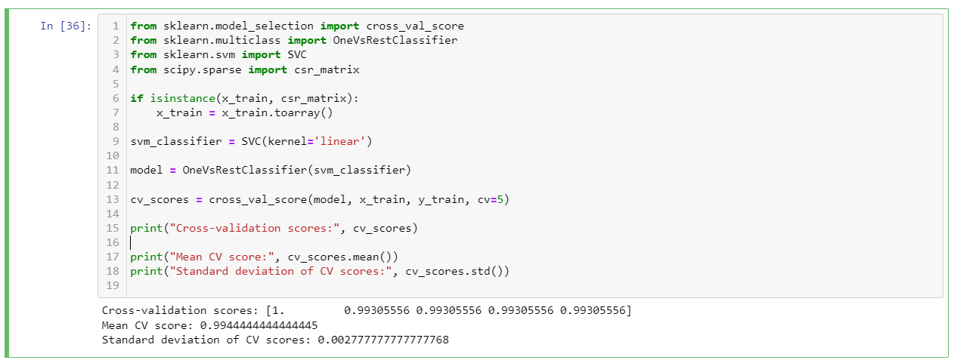
Research Methodology: Model Development
3. Support Vector Machine:
How SVM Performed on our Model?
Cross Validation Scores:
Cross Validation Method Applied: K-folds (K=5)
Cross Validation scores: {1.0,0.99,0.99,0.99,0.99}
Mean Cross Validation scores: 0.9944
Standard deviation of Cross Validation Scores: 0.0027

Slide 45
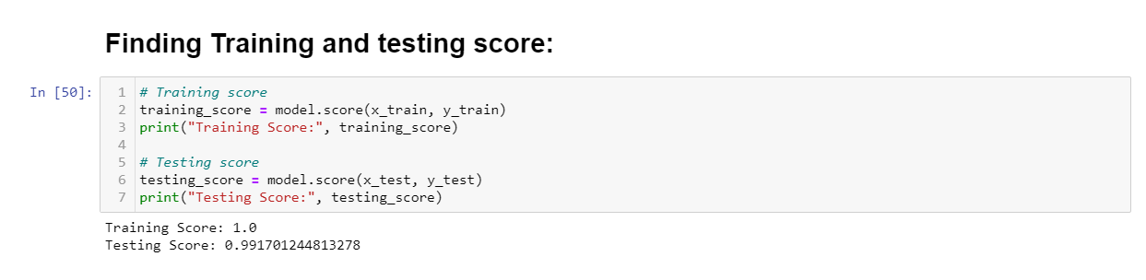
Research Methodology: Model Development
3. Support vector Machine:
How SVM Performed on our Model?
Calculating the Training and Testing Scores:
Training score: 1.0
Testing score: 0.9917
Code:

Slide 46
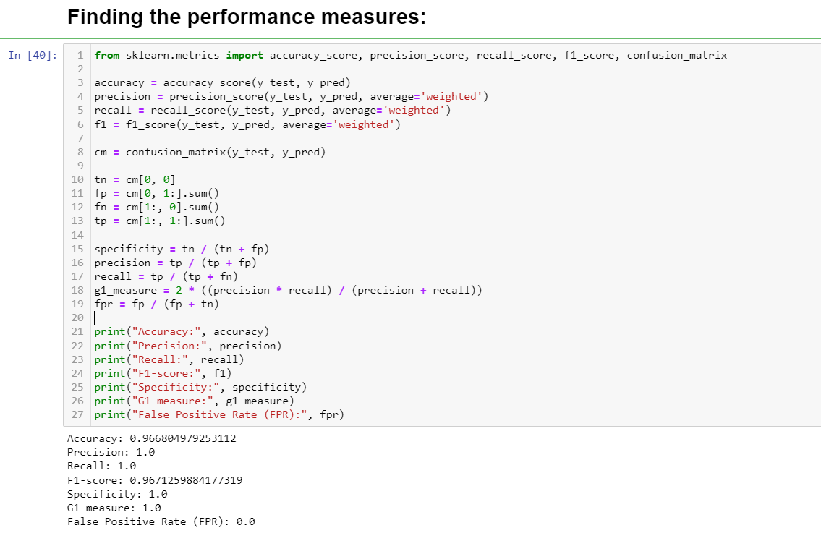
Research Methodology: Model Development
3. Support Vector Machine:
How SVM Performed on our Model?
Performance Measures:
Accuracy: 0.966
Precision: 1.0
Recall: 1.0
F1-Score: 0.967
Specificity: 1.0
G1-measure: 1.0
False Positive Rate: 0.0

Slide 47
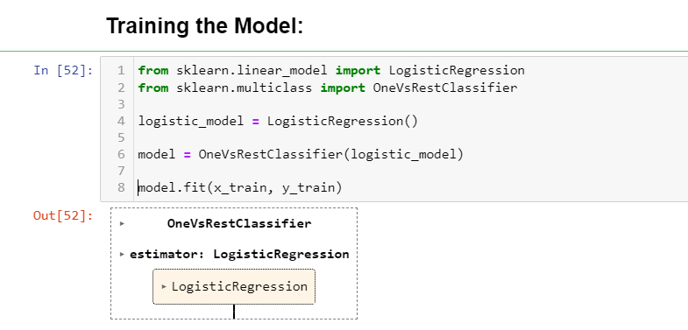
Research Methodology: Model Development
4. Logistic Regression:
Training the model with Logistic Regression:

Slide 48
Research Methodology: Model Development
4. Logistic Regression:
Why Logistic Regression for our Model?
Interpretability and Simplicity: Logistic regression is easy to implement and interpret.
Probabilistic View: Logistic regression predicts probabilities using the Sigmoid function. The output ranges between 0 and 1, representing class probabilities.
No Assumptions About Data Distribution: Unlike other algorithms, logistic regression makes no assumptions about class distributions in feature space.

Slide 49
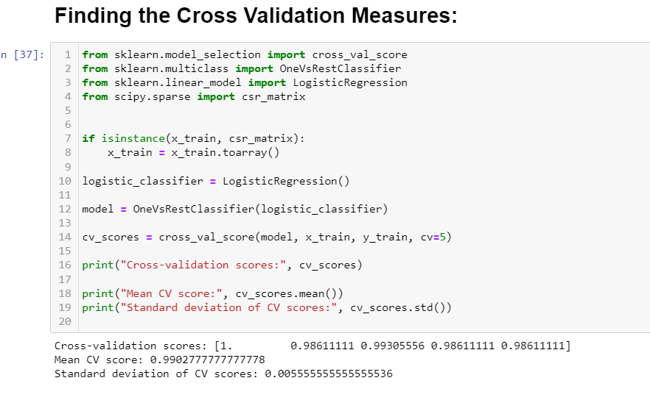
Research Methodology: Model Development
4. Logistic Regression:
How Logistic Regression Performed on our Model?
Cross Validation Scores:
Cross Validation Method Applied: K-folds (K=5)
Cross Validation scores: {1.0,0.986,0.9930,0.9861,0.9861}
Mean Cross Validation scores: 0.9902
Standard deviation of Cross Validation Scores: 0.0055

Slide 50
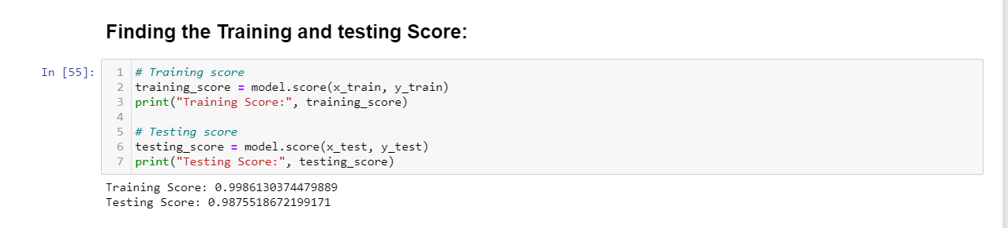
Research Methodology: Model Development
4. Logistic Regression:
How Logistic Regression Performed on our Model?
Calculating the Training and Testing Scores:
Training score: 0.9986
Testing score: 0.9875
Code:

Slide 51
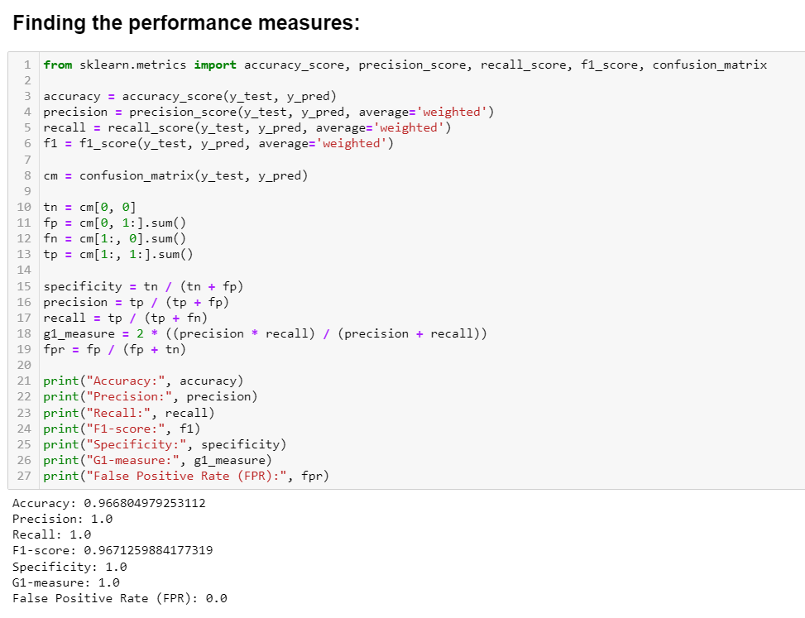
Research Methodology: Model Development
4. Logistic Regression:
How Logistic Regression Performed on our Model?
Performance Measures:
Accuracy: 0.966
Precision: 1.0
Recall: 1.0
F1-Score: 0.967
Specificity: 1.0
G1-measure: 1.0
False Positive Rate: 0.0

Slide 52
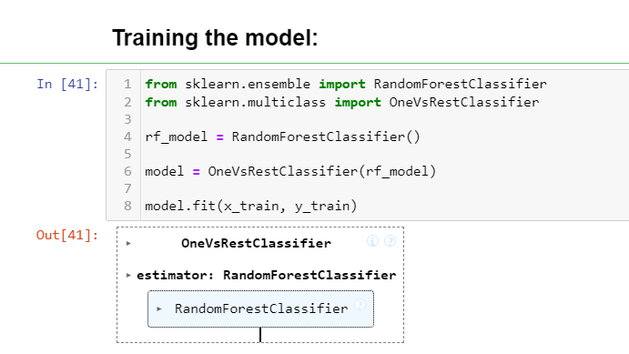
Research Methodology: Model Development
5. Random Forest:
Training the model with Random Forest:

Slide 53
Research Methodology: Model Development
5. Random Forest:
Why Random Forest for our Model?
Handling Complex Data Resumes can be complex, with varying formats, keywords, and structures. Random Forest handles such complexity effectively by aggregating insights from different trees.
Reducing Overfitting: Overfitting occurs when a model learns noise from the training data. Random Forest introduces randomness by using subsets of data and features for each tree, reducing the risk of overfitting.
Stability and Precision: The collaborative decision-making process among multiple trees provides stable and precise results.

Slide 54
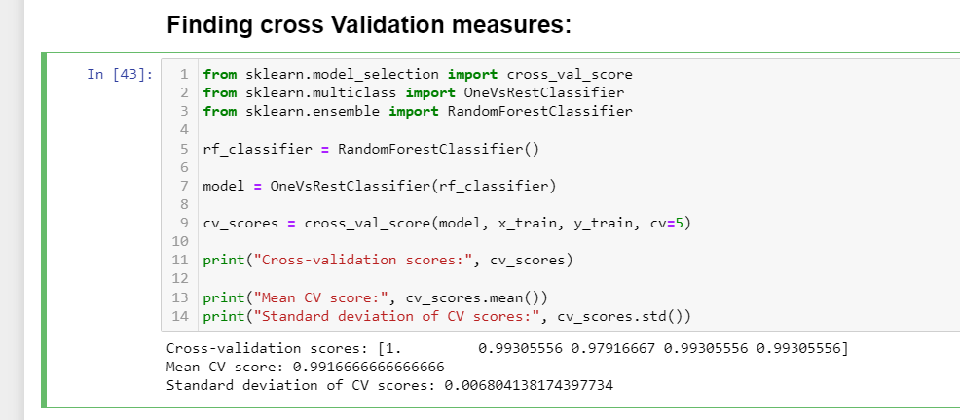
Research Methodology: Model Development
5. Random Forest:
How Random Forest Performed on our Model?
Cross Validation Scores:
Cross Validation Method Applied: K-folds (K=5)
Cross Validation scores: {1.0,0.9930,0.9791,0.9930,0.9930}
Mean Cross Validation scores: 0.9916
Standard deviation of Cross Validation Scores: 0.0068

Slide 55
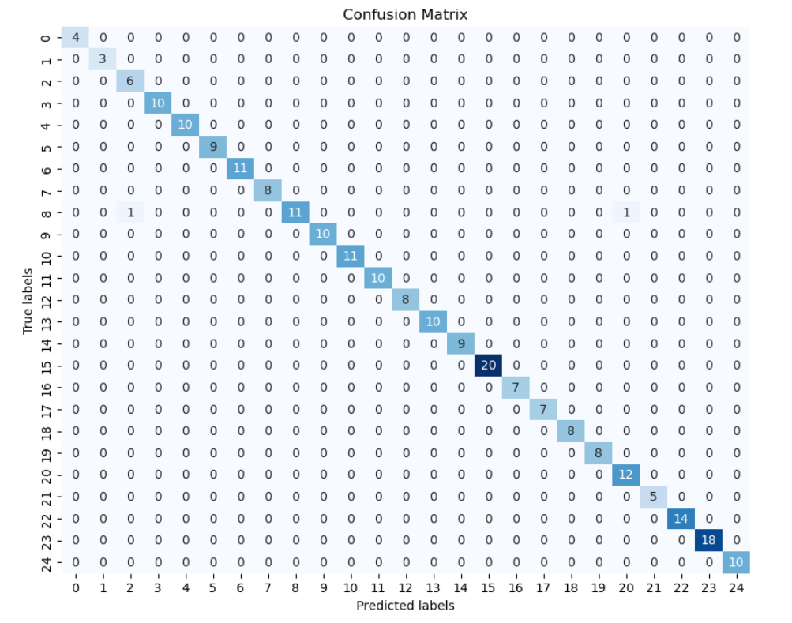
Research Methodology: Model Development
5. Random Forest:
How Random Forest Performed on our Model?
Confusion Matrix:

Slide 56
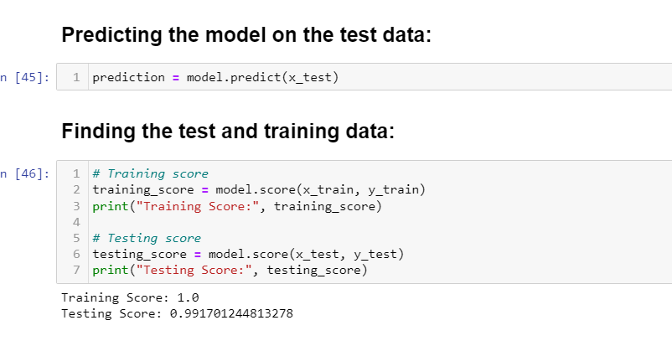
Research Methodology: Model Development
5. Random Forest:
How Random Forest Performed on our Model?
Calculating the Training and Testing Scores:
Training score: 1.0
Testing score: 0.9917
Code:

Slide 57
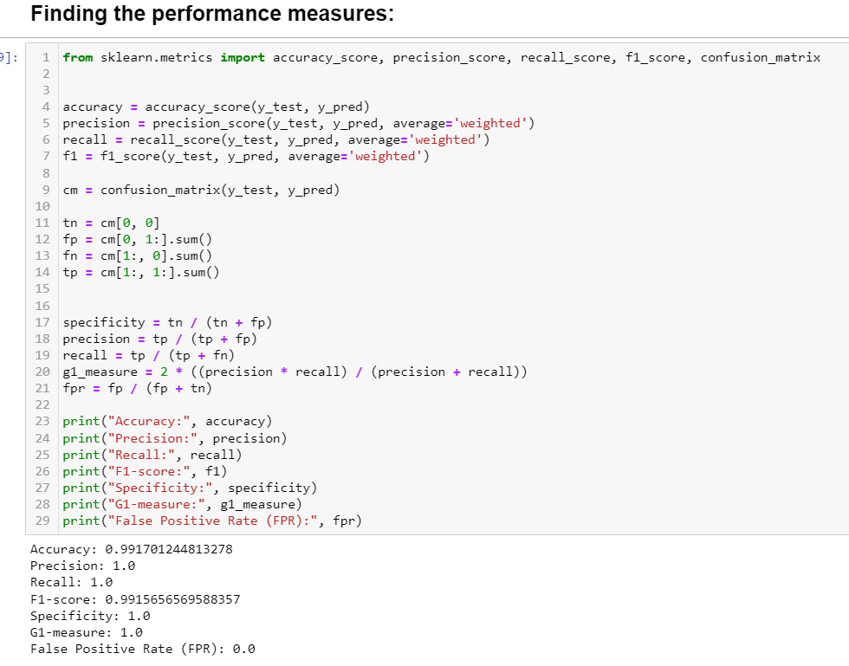
Research Methodology: Model Development
5. Random Forest:
How Random Forest Performed on our Model?
Performance Measures:
Accuracy: 0.9917
Precision: 1.0
Recall: 1.0
F1-Score: 0.9915
Specificity: 1.0
G1-measure: 1.0
False Positive Rate: 0.0

Slide 58
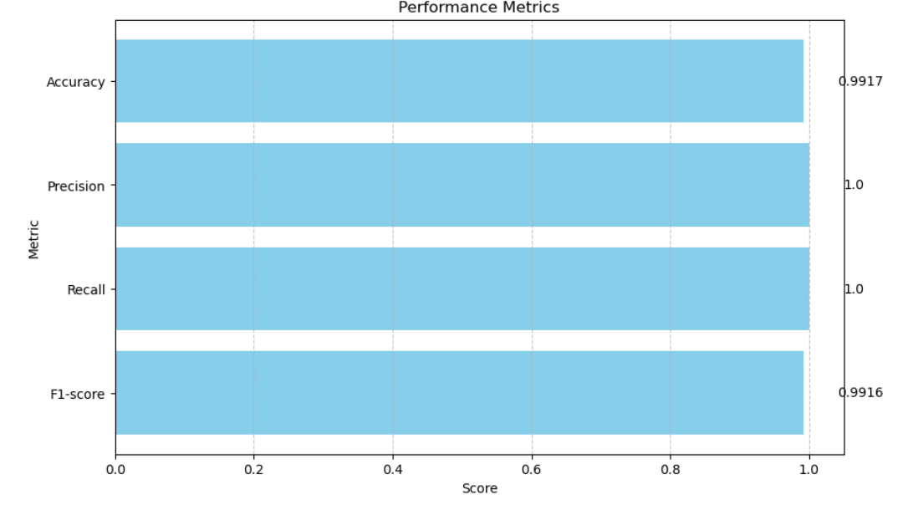
Research Methodology: Model Development
5. Random Forest:
How Random Forest Performed on our Model?
Performances through graphs:

Slide 59
Conclusion
The Algorithm which gives the best Results for our model: Random Forest
Final Result:
Mean Cross validation Score: 0.9916
Accuracy: 0.9917
F1-score: 0.9915
Precision: 1
G1-Measure: 1
False Positive Rate: 0
Testing Score: 0.9917

Slide 60
Limitations
Data Sparsity: The dataset contains only 962 examples, which might limit the model’s ability to generalize well to unseen data. More diverse and extensive data could improve performance.
Overfitting: Achieving high accuracy, precision, and recall on the training data (e.g., Precision = 1) doesn’t guarantee similar performance on new data.
Limited Features: The dataset includes only two columns (Category and Resume). Additional features related to skills, experience, or education could enhance model performance.
Scalability: As the dataset grows, the model’s performance may change. Consider evaluating its scalability as more data becomes available.

